Slide 1
Dabchick Rigging
Malcolm Osborne

Slide 2
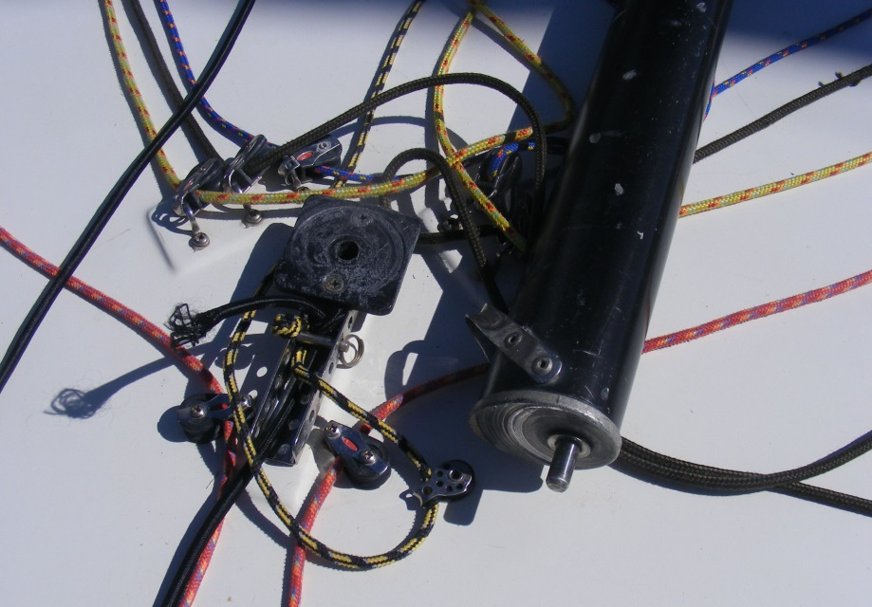
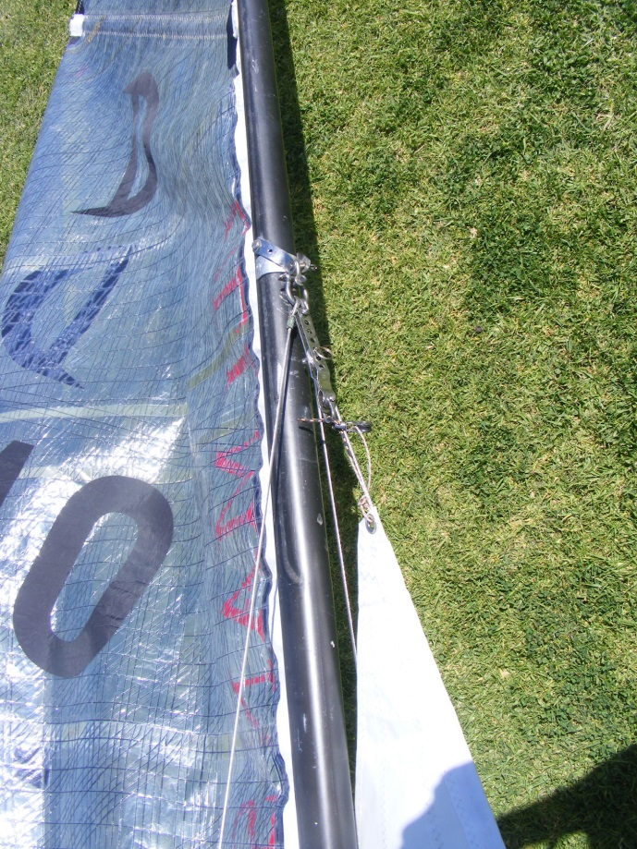
Mast Rigging
Dabchicks are currently rigged for rotating mast – a pin in the mast foot rotates in a nylon block on the deck. At the hounds, all three stays are shackled to a mast tang. By undoing the big shackle, the mast can be removed for storage and the sidestays can stay on the boat.

Slide 3
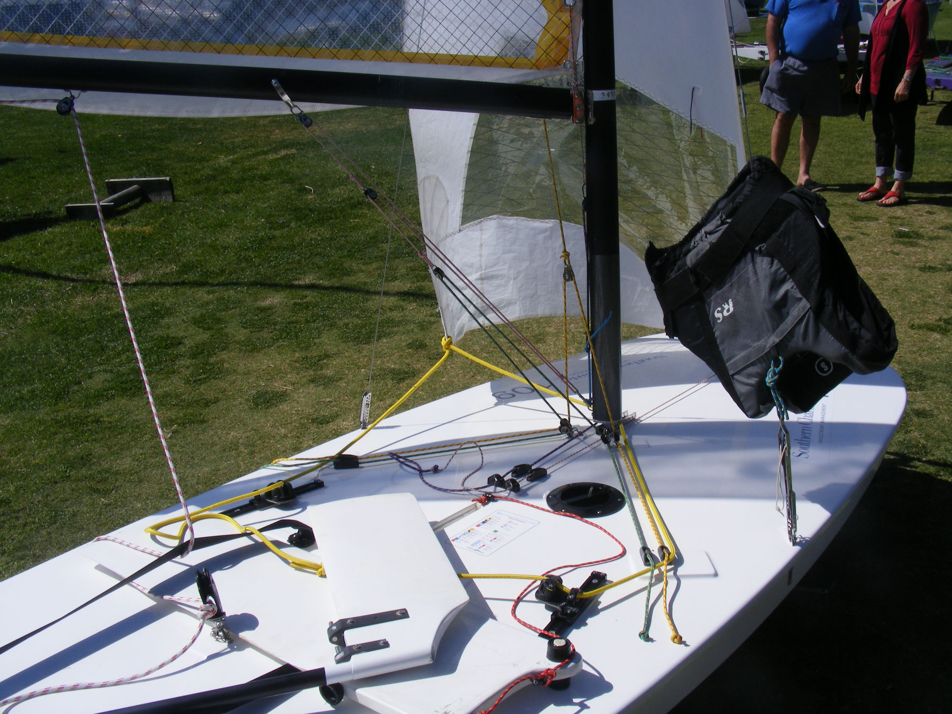
Kicking Strap and Outhaul
The cascade system of the kicking strap is seen in this photo, as well as the outhaul system

Slide 4
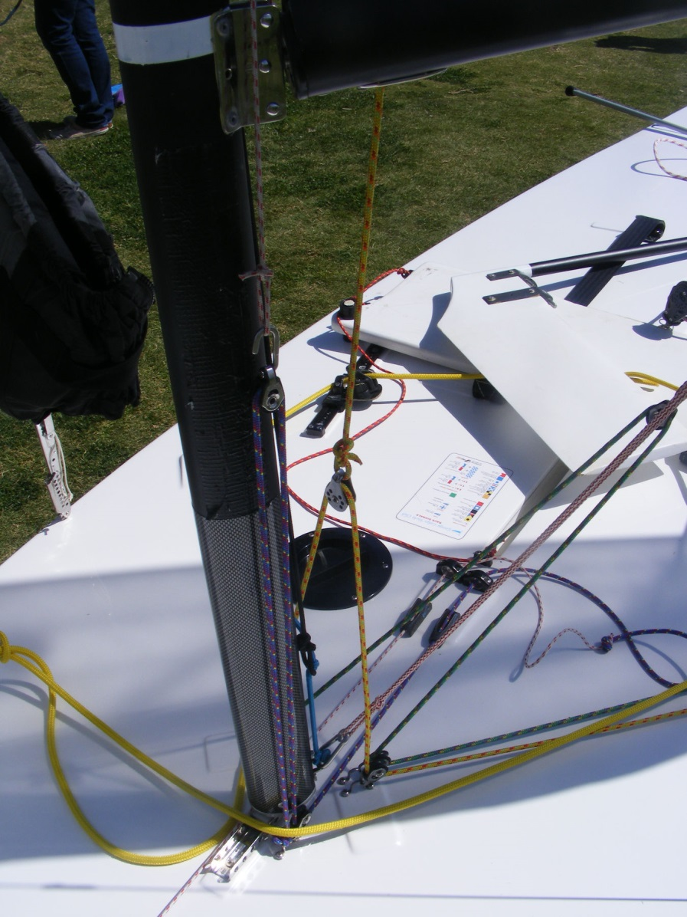
Cunningham Control
Photo showing the mainsail purchase system for cunningham control (purple line).
The other central cleat is for the jib cunningham control.

